Slide 1
String Matching
String Matching with finite automata
Design and Analysis of Algorithm

Slide 2
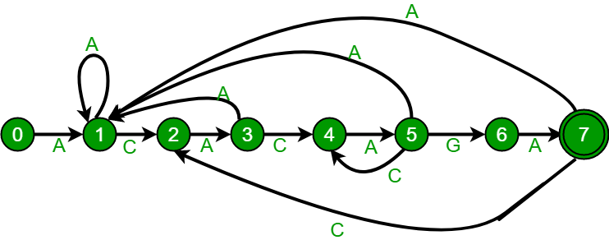
finite-state automaton
A finite-state machine (FSM) or finite-state automaton (FSA, plural: automata), finite automaton, or simply a state machine, is a mathematical model of computation.
It is an abstract machine that can be in exactly one of a finite number of states at any given time.
The FSM can change from one state to another in response to some inputs; the change from one state to another is called a transition

Slide 3
String Matching with finite automata
These algorithms build a finite automaton that scans the text string T for all occurrences of pattern P.
Each text character is examined only once
Time to build the automaton can be large if ∑ is large.

Slide 4
Finite Automata
A finite automaton M is a 5-tuple (Q, q_{o}, A, ∑, δ), where
Q is finite set of states,
q_{o} ∈ Q is the start state,
A ⊆ Q is a distinguished set of accepting states,
∑ is finite input alphabet,
δ is a function from Q x ∑ into Q, called the transition function of M

Slide 5
Finite Automata (Cont’d)
Suppose M is in state q_{o}.
It reads char. a, it moves from state q to state δ(q,a)
Whenever current state q ∈A, the machine M has accepted the string read so far.
An input that is not accepted is said to be rejected

Slide 6
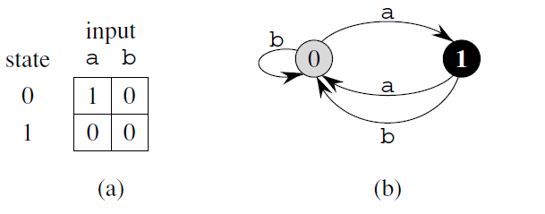
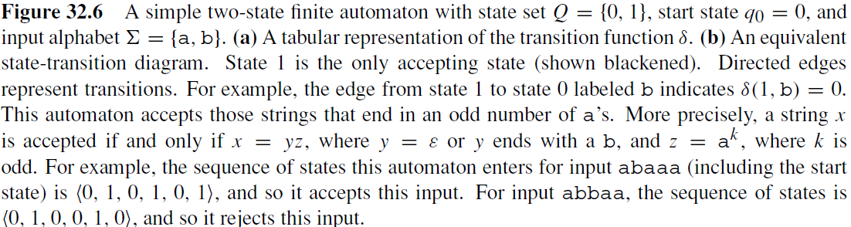

Slide 7
Final-State Function
The automaton M has a final-state function Φ from ∑* to Q, such that:
Φ(w) is the state, M ends up in, after scanning the string w.
M accepts string w if and only if Φ(w) ∈ A.
It is defined recursively as follows:
Φ(w) = q_{o} if w= ε
Φ(wa) = δ(Φ(w), a) for w ∈ ∑*, a ∈∑

Slide 8
String Matching Automata
Every pattern P has finite automaton
It must be built in the preprocessing step
In order to do so, we first define a function called suffix-function σ, corresponding to P
It is a mapping from ∑* to {0,1,…,m} such that:
σ(x) = length of the longest prefix of P that is a suffix of x
σ(x) = max{k : P_{k} ╛x}

Slide 9
String Matching Automata
Suffix function is well defined, since P_{o} = ε is a suffix of every string.
If P=ab, then:
σ(ε) = 0
σ(x) = 0
σ(ccaca) = 1, σ(ccab) = 2

Slide 10
String Matching Automata
σ(x) = m if an only if P is a suffix of x
String Matching Automaton corresponding to a given pattern is defined as:
State Set Q = { 0, 1, 2, ….. M}
Transition function
δ(q, a) = σ(P_{q}a)

Slide 11
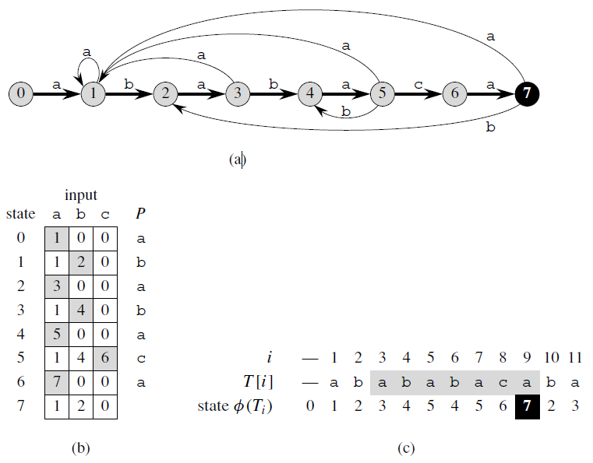

Fig 32.7

Slide 12
String Matching Automata
Figure 32.7 (a) A state-transition diagram for the string-matching automaton that accepts all strings ending in the string ababaca. State 0 is the start state, and state 7 (shown blackened) is the only accepting state. A directed edge from state i to state j labeled a represents δ(i, a) = j. The right-going edges forming the “spine” of the automaton, shown heavy in the figure, correspond to successful matches between pattern and input characters. The left-going edges correspond to failing matches. Some edges corresponding to failing matches are not shown; by convention, if a state I has no outgoing edge labeled a for some a ∈ , then δ(i, a) = 0. (b) The corresponding transition function δ, and the pattern string P = ababaca. The entries corresponding to successful matches between pattern and input characters are shown shaded. (c) The operation of the automaton on the text T = abababacaba. Under each text character T [i ] is given the state φ(Ti ) the automaton is in after processing the prefix Ti . One occurrence of the pattern is found, ending in position 9.

Slide 13
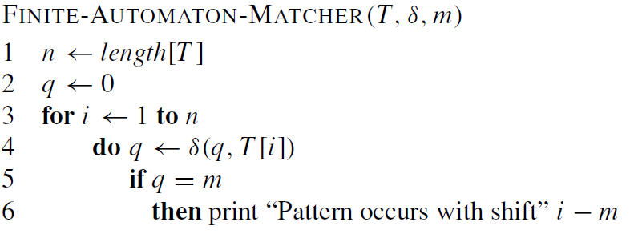

Slide 14
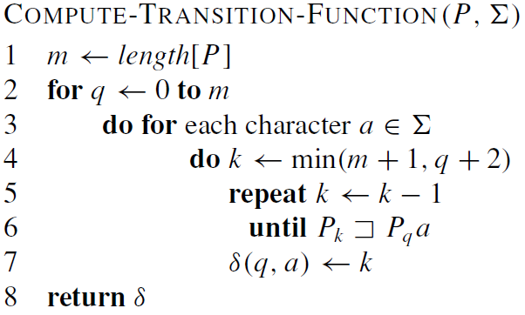

Slide 15
the inner repeat loop can run at most m+1 times
and the test Pk ╛ Pqa on line 7 can require comparing up to m characters

Slide 16
Reference
Introduction to Algorithms
Thomas H. Cormen
Chapter # 32

